Slide 1
Boxercise at Integral Gym

Slide 2
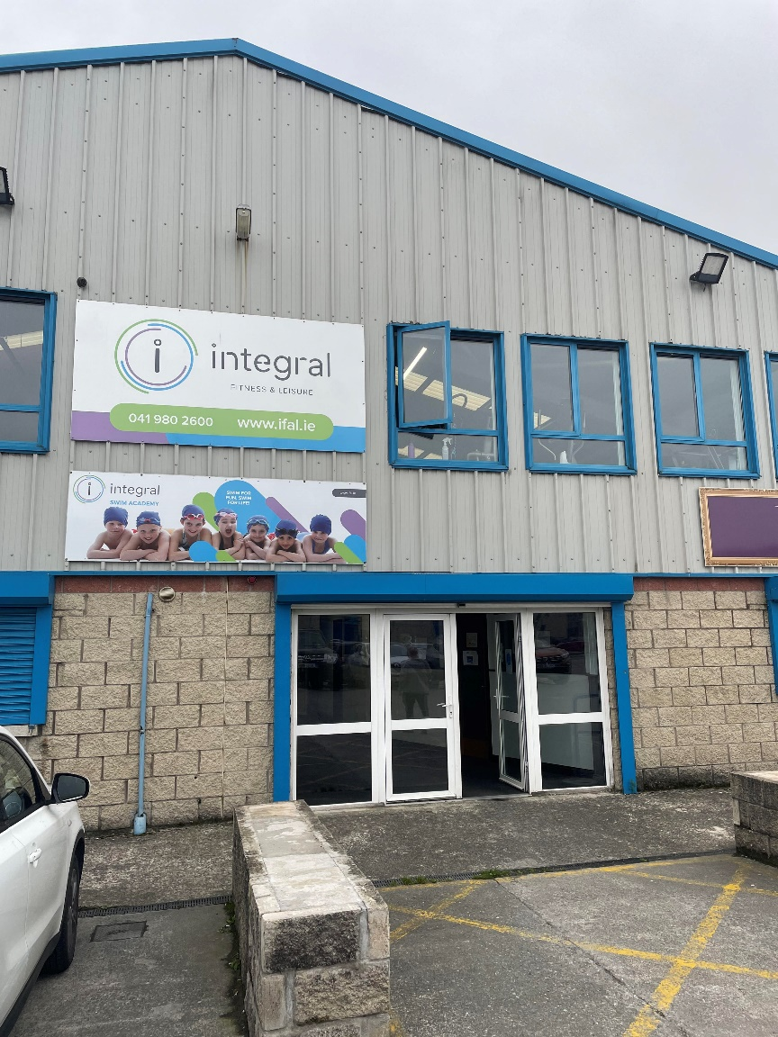
This is The Integral Gym.
Boxercise classes take place here.
This is the front door.

Slide 3
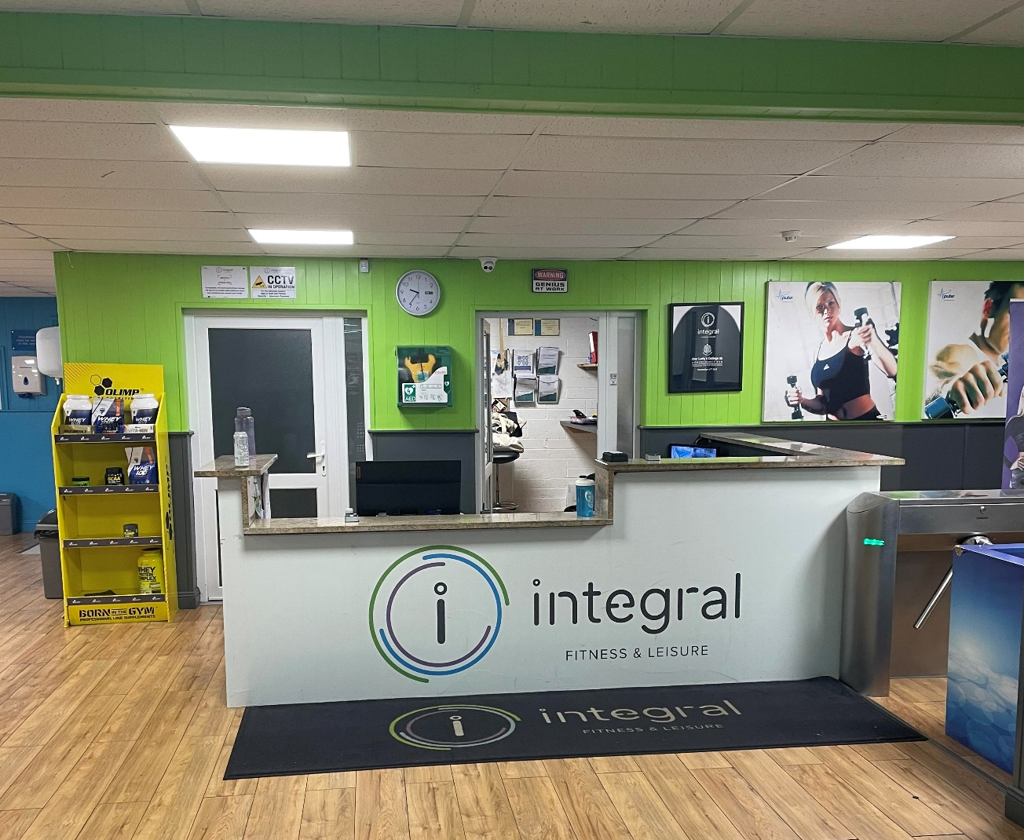
This is the reception desk.
Some of the integral staff will be here to greet you.
I can sign in and pay here.

Slide 4
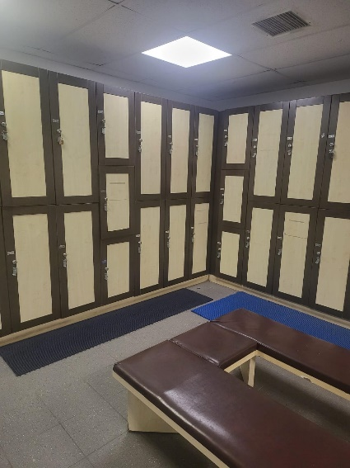
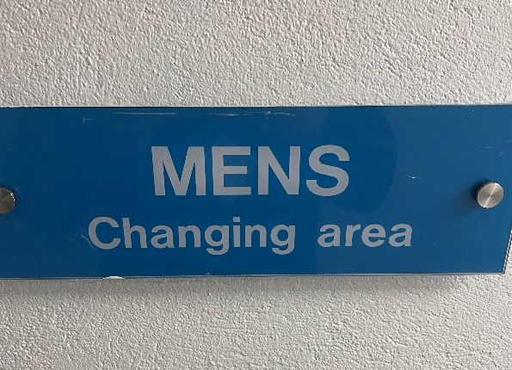
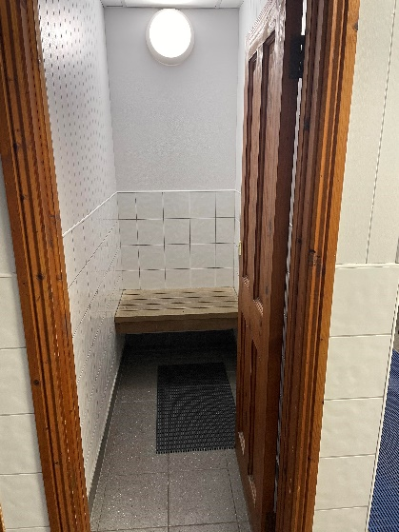
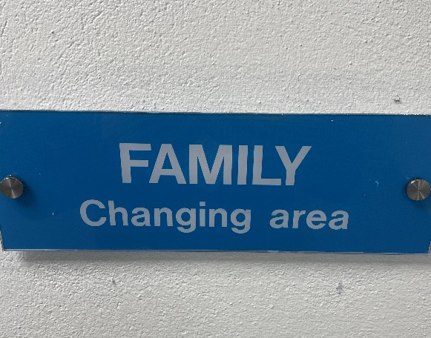
These are the changing rooms. I can choose either men’s or women’s. I can go here to get changed.
If I want more privacy I can use a cubical in the family changing room.

Slide 5
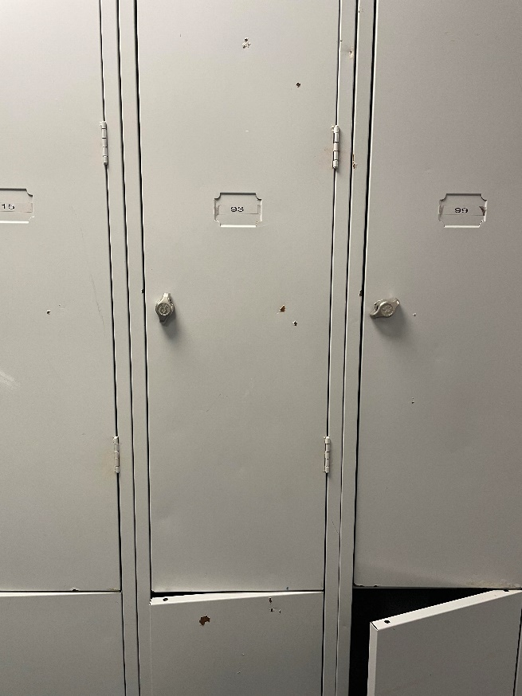
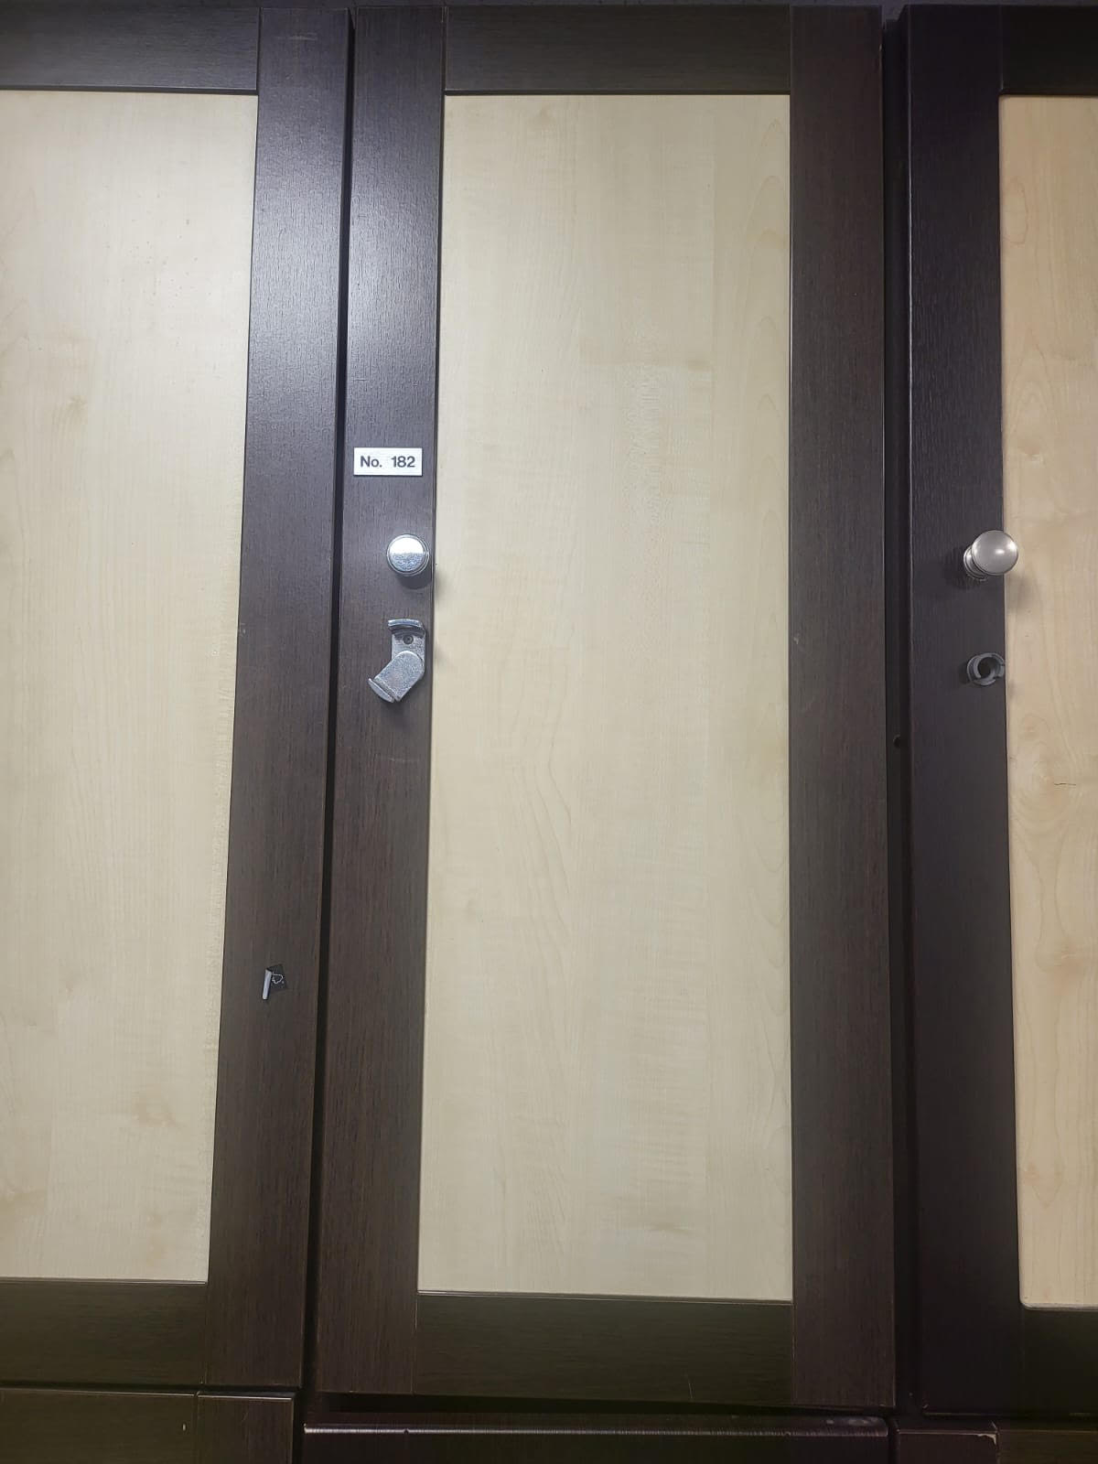
These are the lockers. I can store my bag and my belongings here if I need to.
I can bring a padlock if I want to lock it.
I need to remember which number locker I put my things in.

Slide 6
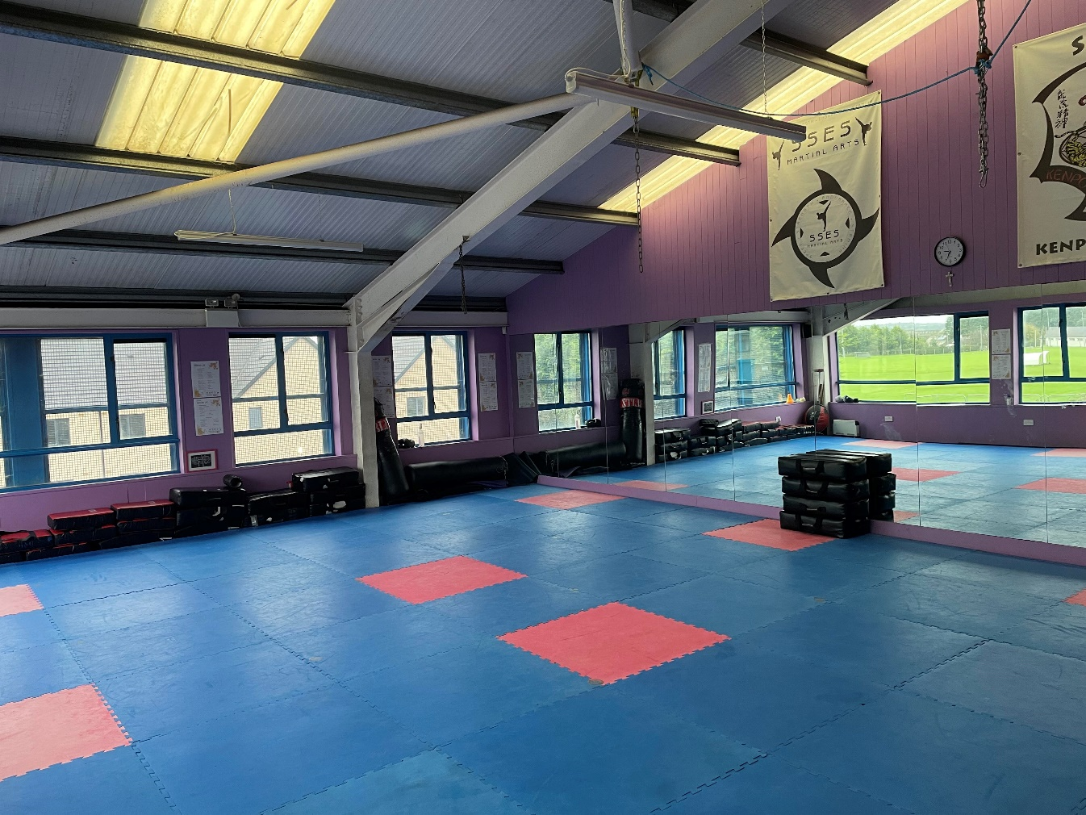
This is the studio where class will take place.
I will meet the staff and my friends here.
The staff might do a small warm-up before class begins and guide me through the lesson.

Slide 7
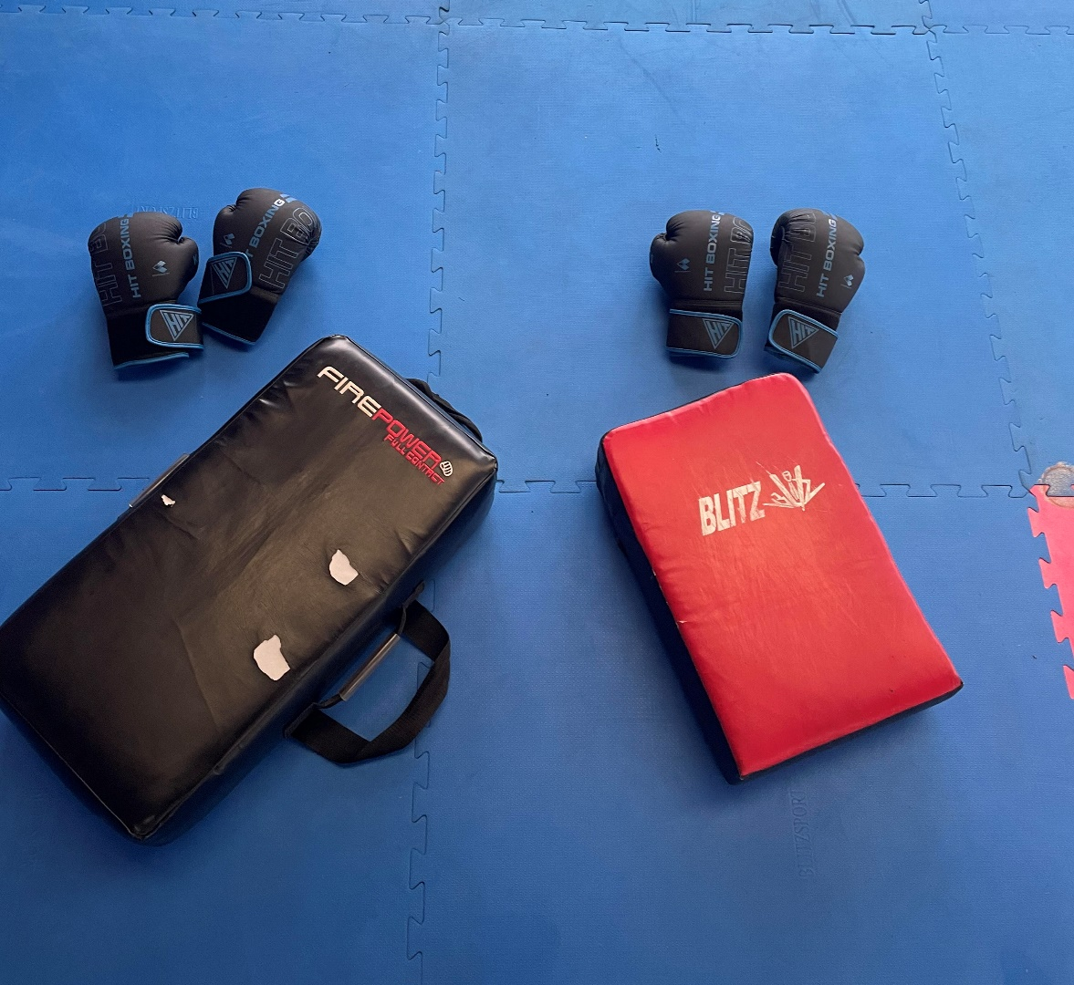
This is the boxercise equipment we will use.
The staff will tell me when we are using the equipment and show me how.
I can bring a water bottle and a towel with me.

Slide 8
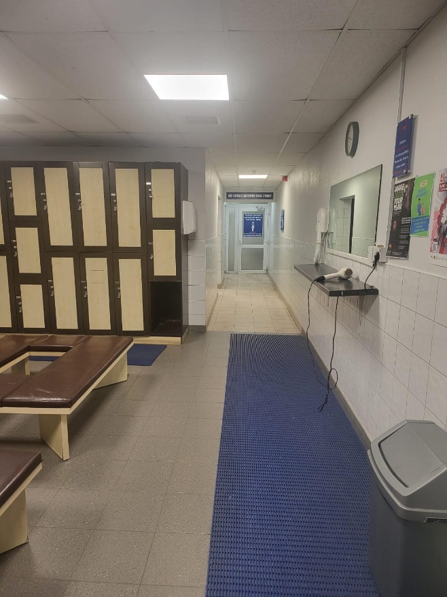
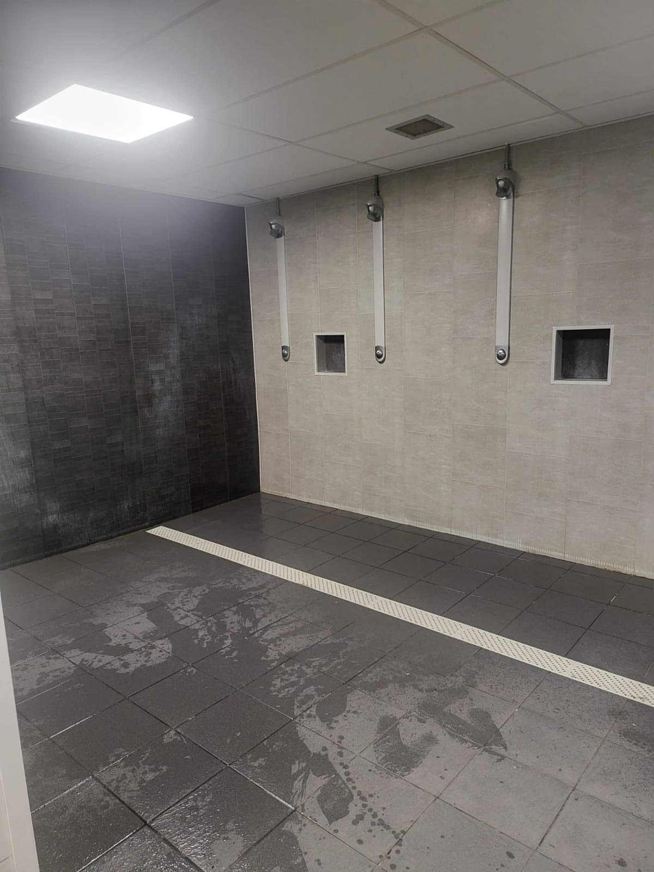
When class is over I can go back to the changing room.
I can get my stuff out of my locker.
There are showers here I can use if I want to use them after class.
There are also toilets here I can use at any time.

Slide 9
When Boxercise is over I will be collected at the door.
Then I will go home.
Bye bye Boxercise, See you next week!

